Slide 1
We’re separate because...
How we think about Diet and Health!

Slide 2
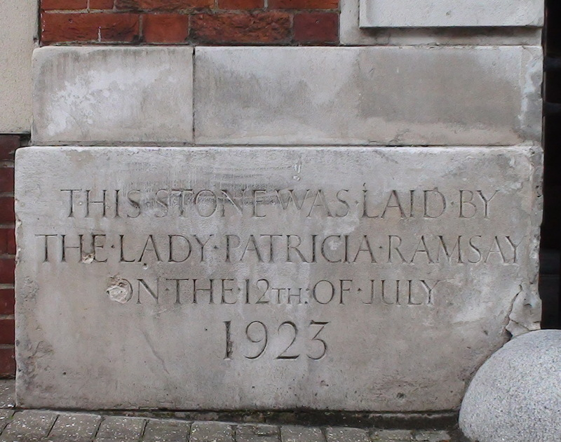
Establishing Foundation Stones - 1
“In most cases, what the Bible calls ‘blessing’ is simple the consequence of obedience”

Slide 3
Discipline, carrots & sticks
Discipline / development
External Agency
Us & Our Behaviour
Consequences

Slide 4
Example 1 – Car maintenance
2 scenarios

Slide 5
Example 2 – Fertility
¹³ He will love you and bless you and increase your numbers. He will bless the fruit of your womb, the crops of your land—your grain, new wine and olive oil—the calves of your herds and the lambs of your flocks in the land he swore to your ancestors to give you. ¹⁴ You will be blessed more than any other people; none of your men or women will be childless. . . (Deuteronomy 7)

Slide 6
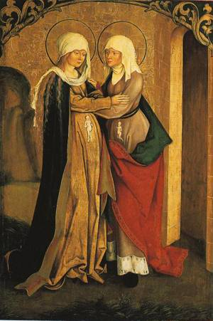
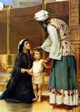
Fertility? Scenario 1
Hazelelponi - Samson
Hannah - Samuel
Elizabeth - John

Slide 7
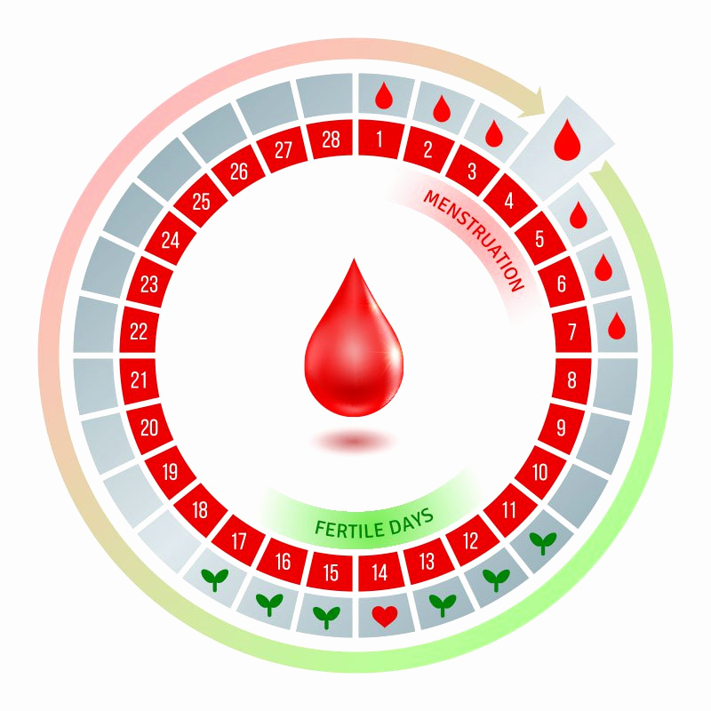
Fertility? Scenario 2
End of ‘period’
Conclusion of 7 days of ‘impurity’
¹⁹ “‘When a woman has her regular flow of blood, the impurity of her monthly period will last seven days, and anyone who touches her will be unclean till evening. (Lev 15)

Slide 8
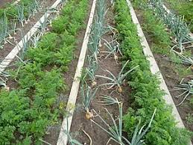
Conclusions 1?
‘Good’ consequences arise from wise behaviour
God teaches us wise behaviour
Obedience produces ‘good’ consequences
Exceptions do NOT disprove the ‘rule’ – quite the opposite
We won’t always understand why!

Slide 9
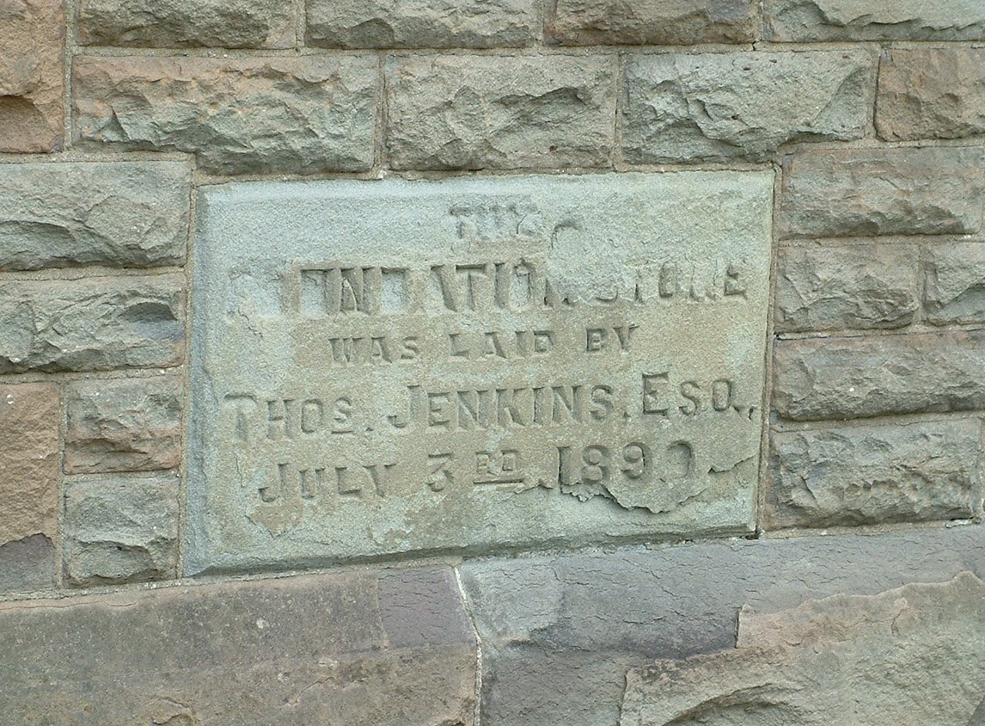
Establishing Foundations Stones – 2
Though God is unchanging, his commands toward us do change

Slide 10
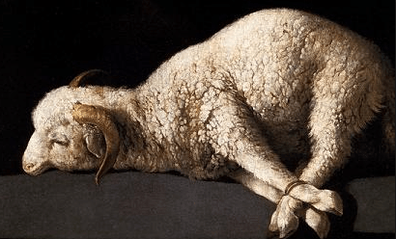
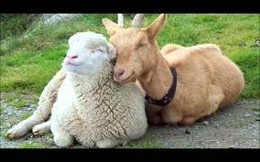
Example – Sacrifice
God does not ‘tolerate’ sin
God directs how to ‘deal with’ sin/guilt
The Fall
Sinai
Calvary
Animal sacrifice
Anyone / anywhere
Animal sacrifice
Priest / Temple
Blood of Christ
Come boldly. . .

Slide 11
Dispensationalism

Slide 12
Conclusions 2?
God is unchanging
God’s intentions toward us do not alter
What God tells us to do (or allows us to do) may change.

Slide 13
Foundation Stones Summary
‘Blessings’ are mostly consequences of wise/good behaviour.
Though God is unchanging, his commands to us do change.

Slide 14
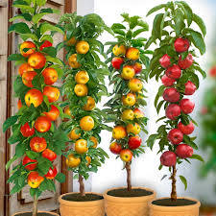
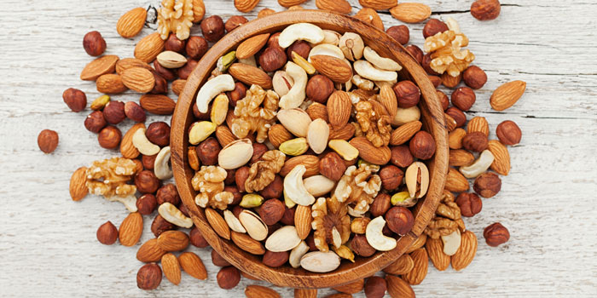
Health? The Manufacturer’s Specification
Genesis 1 diet
²⁹ Then God said, “I give you every seed-bearing plant on the face of the whole earth and every tree that has fruit with seed in it. They will be yours for food.

Slide 15
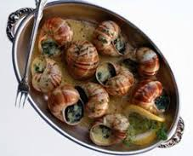
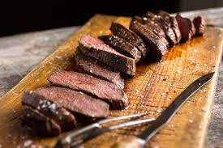
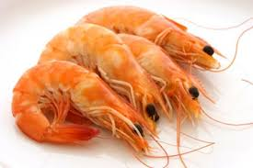
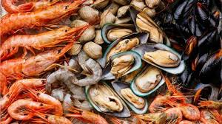
Flood diet
Genesis 9
³ Everything that lives and moves about will be food for you. Just as I gave you the green plants, I now give you everything.

Slide 16
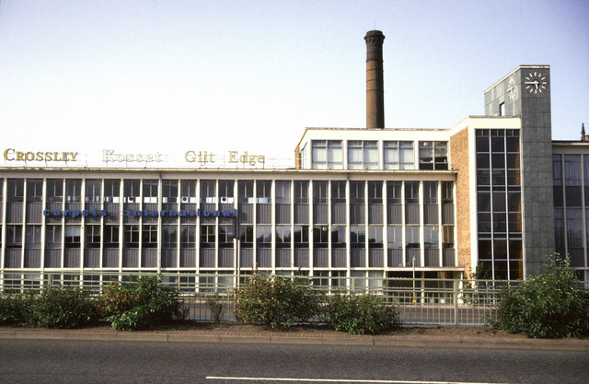
Explaining the options
Clean & Unclean animals went into the ark. . . Therefore. . .
Everything that lives and moves about . . .

Slide 17
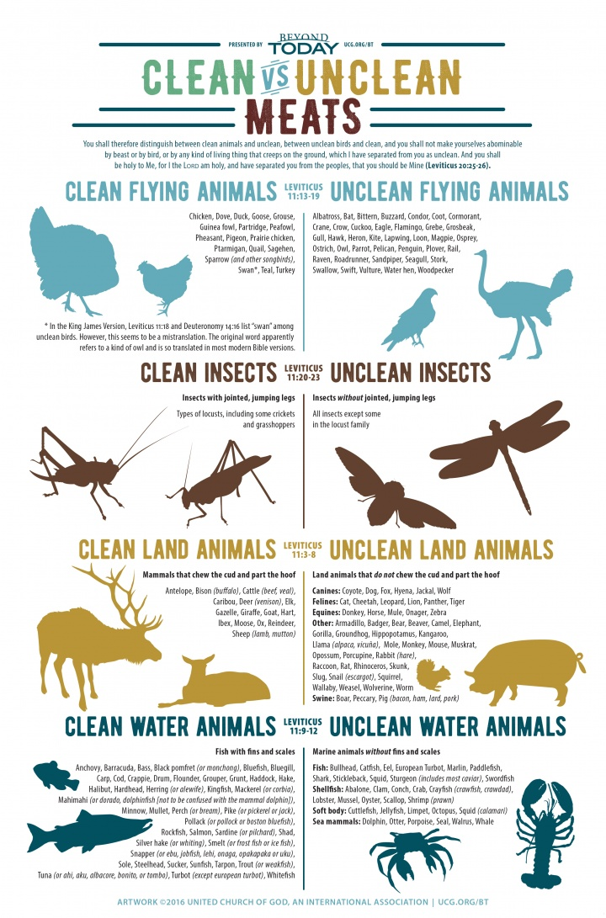
Sinai Diet vs Egyptian
Herodotus wrote: “The Egyptians are the healthiest of all men, next to the Libyans; . . .They eat bread, making loaves which they call “cyllestis," of coarse grain. For wine, they use a drink made from barley, for they have no vines in their country. They eat fish either raw and sun-dried, or preserved with brine. Quails and ducks and small birds are salted and eaten raw; all other kinds of birds, as well as fish (except those that the Egyptians consider sacred) are eaten roasted or boiled." (484 – 425BC)
Then Re said: "The pig is an abomination to Horus." "Would that he might recover," said the gods. That is how the pig became an abomination to the gods, as well as men, for Horus' sake..." .
Notes:
Coffin Text: The Tale of Horus and the Pig, (c. 1900 B.C.): Why the Egyptians did not eat pork: “O Batit of the evening, you swamp-dwellers, you of Mendes, ye of Buto, you of the shade of Re which knows not praise, you who brew stoppered beer---do you know why Rekhyt [Lower Egypt] was given to Horus? It was Re who gave it to him in recompense for the injury in his eye. It was Re--he said to Horus: "Pray, let me see your eye since this has happened to it" [injured in the fight with Seth]. [Source: A. de Buck, “The Egyptian Coffin Texts," (Chicago, 1918), p. 326, Internet Ancient History Sourcebook: Egypt, Fordham University]
Then Re saw it. Re said: "Pray, look at that injury in your eye, while your hand is a covering over the good eye which is there." Then Horus looked at that injury. It assumed the form of a black pig. Thereupon Horus shrieked because of the state of his eye, which was stormy [inflamed]. Horus said: "Behold, my eye is as at that first blow which Seth made against my eye!" Thereupon Horus swallowed his heart before him [lost consciousness].
Then Re said: "Put him upon his bed until he has recovered." It was Seth---he has assumed form against him as a black pig; thereupon he shot a blow into his eye. Then Re said: "The pig is an abomination to Horus." "Would that he might recover," said the gods. That is how the pig became an abomination to the gods, as well as men, for Horus' sake..."

Slide 18
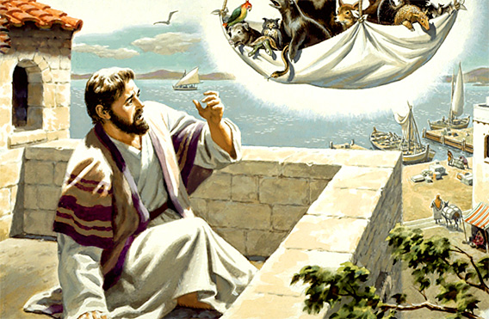
Peter’s vision
Acts 10
The voice spoke to him a second time, “Do not call anything impure that God has made clean.” (vs 15)
. . . Then they asked Peter to stay with them for a few days. (vs 48).

Slide 19
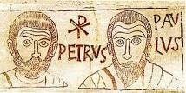
Eating with Gentiles?
¹¹ When Cephas came to Antioch, I opposed him to his face, because he stood condemned. ¹² For before certain men came from James, he used to eat with the Gentiles. But when they arrived, he began to draw back and separate himself from the Gentiles. . .
(Galatians 2).

Slide 20
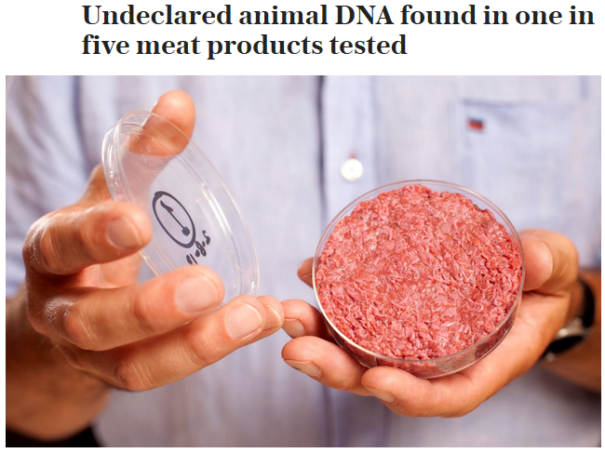
Reality of meat eating
Telegraph – 5th September 2018

Slide 21
Wrapping it up. . .
Do not be deceived: God cannot be mocked. A man reaps what he sows. Galatians 6:7
‘I have the right to do anything,’ you say – but not everything is beneficial. 1 Corinthians 10:23
Health
Temperance
Temperance referred not specially to drink, but to all pleasures; and it meant not abstaining, but going the right length and no further.
CS Lewis (MC)
The enemy changes his coat.

Slide 22
Finally. . .
‘Blessings’ are, for the most part, simply consequences
Good consequences come from following wise advice
The greatest wisdom is God’s
The question. . .
Are we smart enough to live by His advice?

